Slide 1
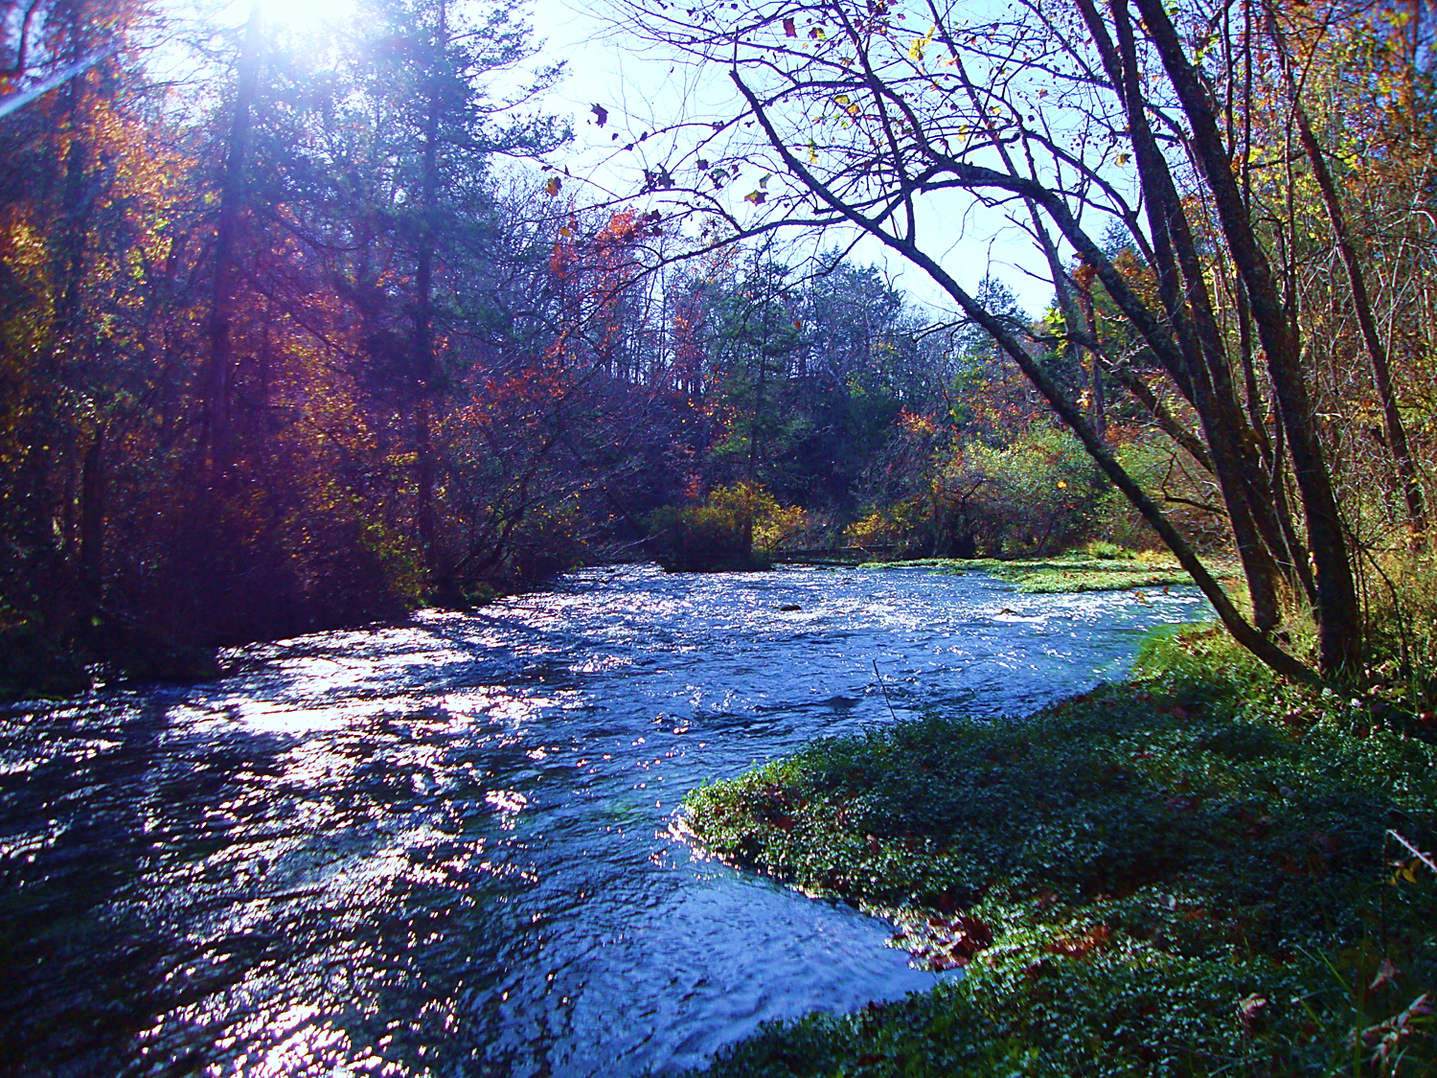
OZARK RIVERS SOLID WASTE MANAGEMENT DISTRICT

Slide 2
Senate Bill 530, 1990
Established a 40% waste diversion goal with a target date of 1998 (260.225.2(3) RSMO)
Created landfill bans for:
Whole tires (January 1, 1991)
Large appliances (white goods) (January 1, 1991)
Lead acid batteries (January 1, 1991)
Yard waste (January 1, 1992)
Led to the formation of the existing 20 regional solid waste management districts, the tipping fee and the solid waste management fund to finance waste diversion efforts.

Slide 3
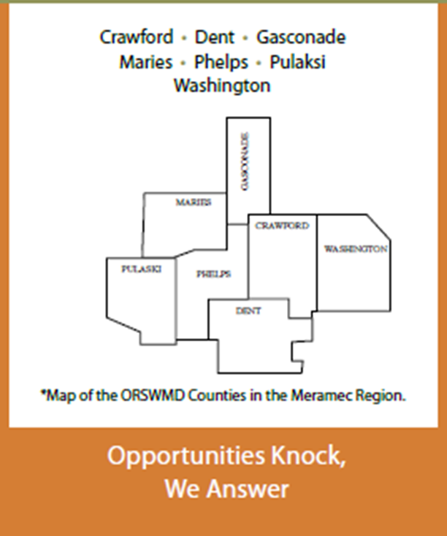
ORSWMD – Seven Counties

Slide 4
Challenges for Rural Missouri
Challenge: Fewer landfills
Solution: Increase participation in reducing solid waste from entering landfills.
Notes:
Originally seven landfills served this area; these have all closed, and our region now has three transfer stations and two landfills, one in Crawford County and one Washington County.

Slide 5
Where Does Our Garbage Go? Transfer Stations
Notes:
Transfer stations are more costly as charges occur at the transfer station and then again at the landfill. Current landfill cost is $50/ton

Slide 6
Where Does Our Garbage Go? Landfills
Notes:
There are 3 regional land in Missouri’s SE region covering 28 counties; some counties use Black Oak, outside of our OR district
That means more than 10% of the landfills in the state are in our SE region;

Slide 7
MERAMEC REGION POPULATION 1950 - 2010
Notes:
Landfills are a vital component for economic growth. At this time, there are no new landfills slated to open in the future.
While we are fortunate to have a permitted SW disposal in our district, waste diversion and minimization is needed for municipal, industrial
and institutional wastes.
The commitment and leadership of local officials are needed to set policies which strengthen planning and programs to grow an waste management system
that combines waste reduction, reuse, recycling, composting, safe disposal practices and education.

Slide 8
ORSWMD POPULATION GROWTH
7 of 8 Counties showed Population Increase
Pulaski: +27% (52,274 - 5th fastest growing county)
Phelps: +13.4% (45,156)
Crawford: +8.3 (24,696)
Washington: +7.9 (25,195)
Dent: +4.9 (15,657)
Maries: +3.1 (9,176)
Gasconade: -0.8% (15,222)
Notes:
Population growth requires planning for increases in waste.
How can we as a solid waste management district increase knowledge about waste as a potential resources?

Slide 9
ORSWMD POPULATION GROWTH
With growing populations, how do we preserve landfills?
Notes:
How can we as a region promote practices that reduce waste?

Slide 10
ORSWMD Rethinking Waste
“Waste is not only an environmental problem, but also an economic loss.” – EEA
“Pollution is nothing but the resources we are not harvesting. We allow them to be dispersed because we’ve been ignorant of their value.” – R. Buckminster Fuller
“Waste is a Misplaced Resource” – Bureau of Energy Efficiency

Slide 11
Challenges for Waste Management in Rural Communities?
Access to residential recycling services
Participation in residential recycling services
Distance for transporting recycled materials
Soft markets for selling recycled materials
Lack of local end-users for materials
Smaller rural populations mean it’s harder to collect enough material to make recycling feasible

Slide 12
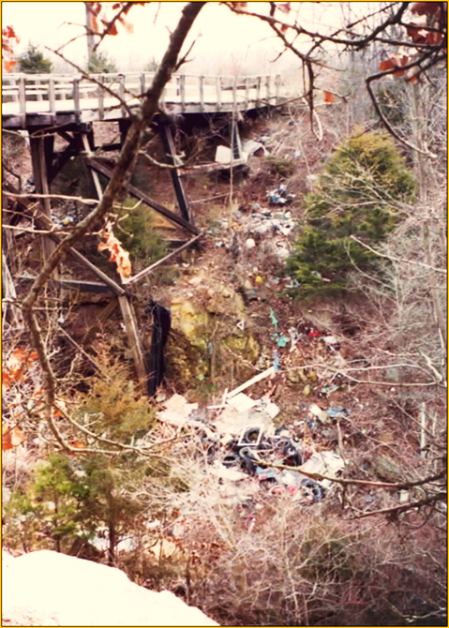
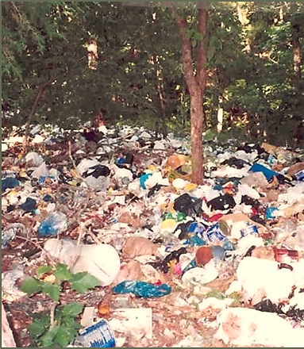
Common Strategies for Rural Solid Waste Management
Notes:
Illegal dumping is often a strategy for rural residents. Please inform us when first accumulations are identified, it is important
to address dumping before it becomes a major problem. What’s in that pile? Stoves, refrigerators, toilets, tires, engine parts, construction waste.

Slide 13
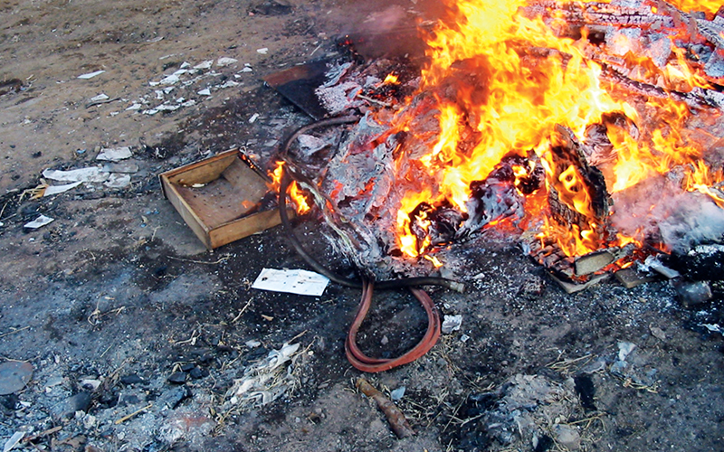
Common Strategies for Rural Solid Waste Management
Notes:
This is not your father’s trash pile. Garbage has changed as today’s household trash contains a lot of plastics and paper treated with chemicals and coatings. Burning is not the best management strategy due to the resulting smoke at ground level that’s easily inhaled. The remaining ash contains concentrated amounts of toxic materials that may blow away or seep into the soil and groundwater.

Slide 14
ORSWMD’s Strategies for Rural Waste Management
Special Collections
Household Hazardous Waste
Illegal Dump Cleanups/Prevention
Raising Awareness and Education
Environmental Education in Schools
District Grant Funded Projects in the Region
Technical Assistance for Communities

Slide 15
Special Collections
Each year ORSWMD holds special collections throughout the district for the following:
Appliances
Metals
Tires (residential only)
Electronics (anything with a cord)

Slide 16
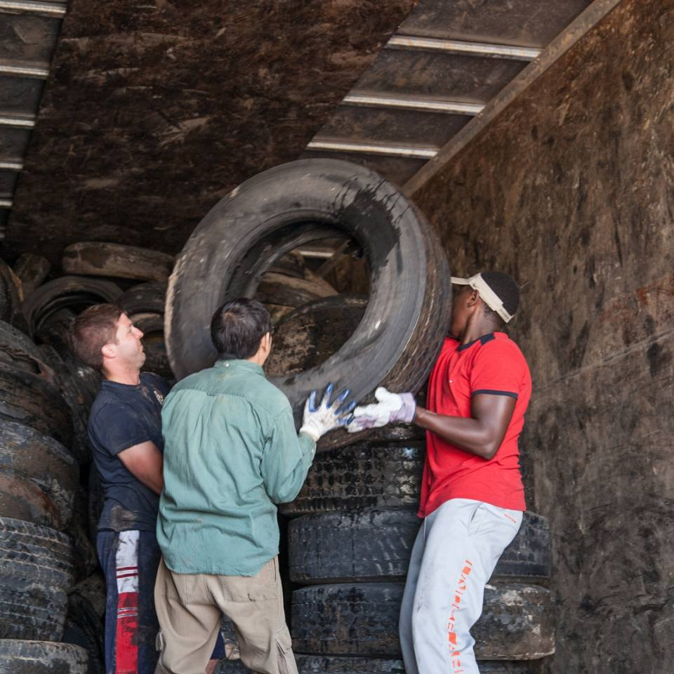
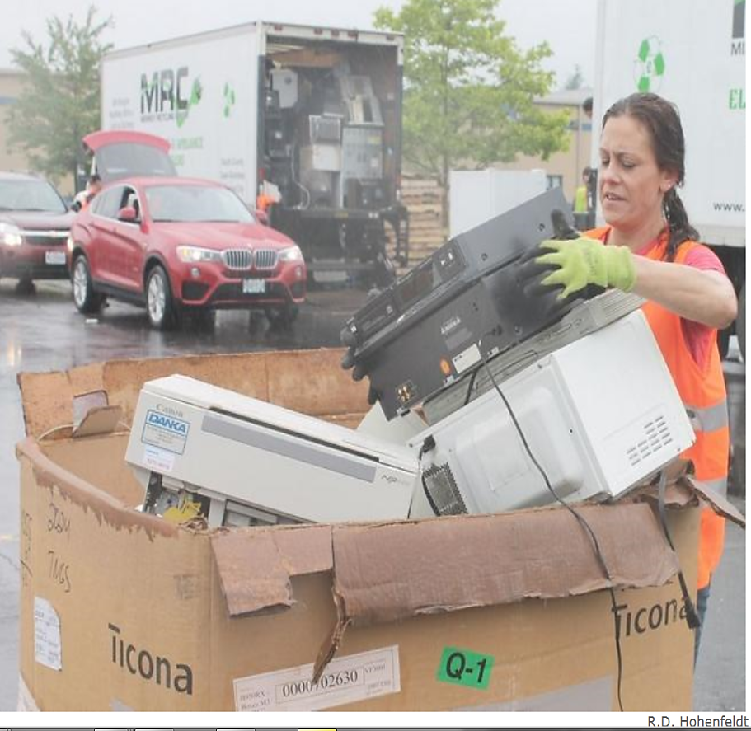
Special Collections
Since 2011
Households served: 2,400
Tons collected: 250 tons
Notes:
Special collections are subsidized by the district. The district collects money from residents for tires according to their size. We also collect a reduced fee for CRT televisions and computer monitors an prices will be increasing. Starting in 2017, there may be additional charges for appliances with Freon.

Slide 17
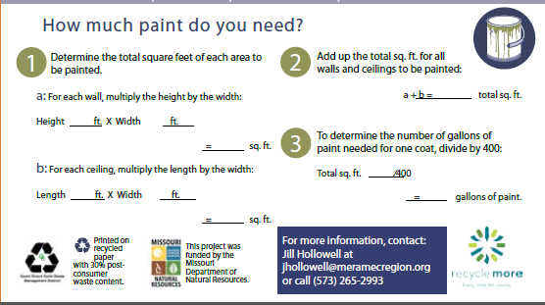

Slide 18
HHW Guidelines
Accepted
Stain, varnish, paint, thinner…
Adhesives-glue, epoxy, caulk, wood filler……
Auto- antifreeze, gas, batteries, motor oil….
Garden-pesticides, herbicides, insecticides..
Misc.- HH cleaners, pool chemicals, mercury……
Not accepted
Asbestos
Explosives
Compressed gases
Smoke detector
Radioactive materials
Sharps/syringes
Ammunition
Fireworks

Slide 19
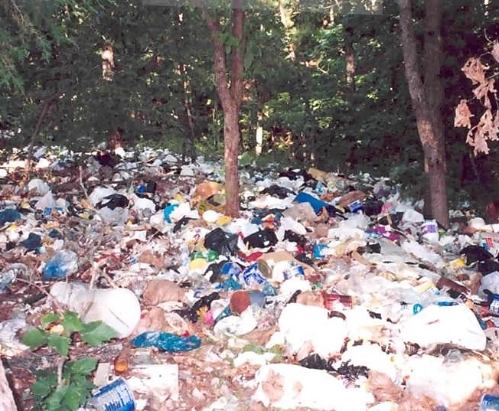
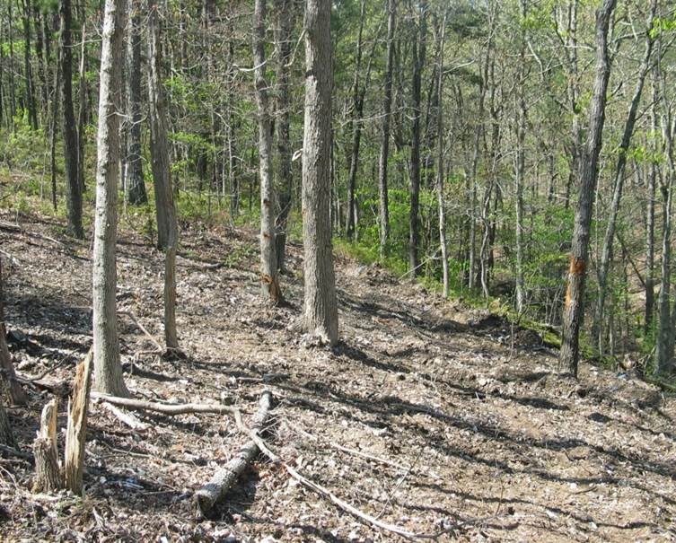
Illegal Dump Program
Community prevention and cleanup programs
Prevention through awareness and volunteer dump site adoption
Prevention plan reinforced with surveillance cameras
Dumpsite cleanup program with volunteer support
800 TONS OF TRASH !!!
Before clean-up
After clean-up
Notes:
799.12 tons of trash; more than 100 sites since 2004.

Slide 20
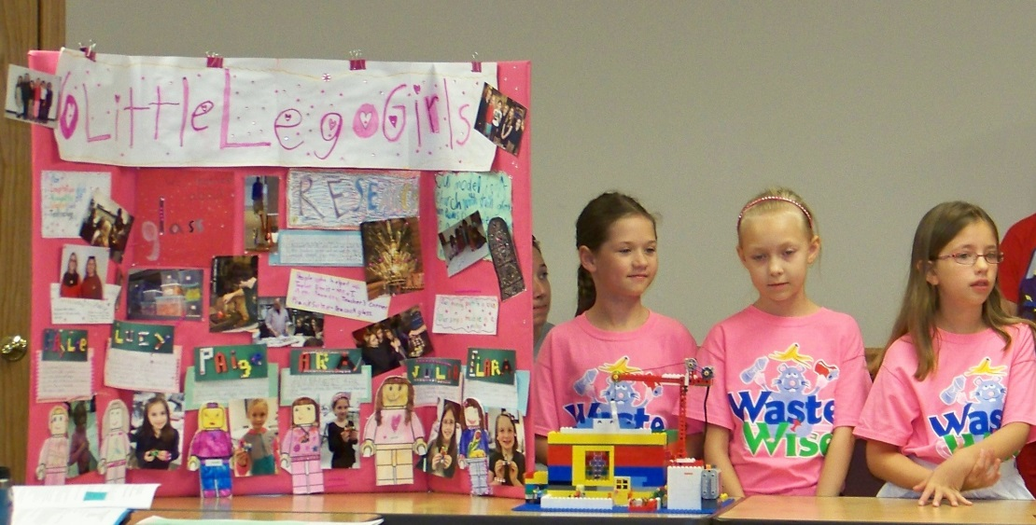
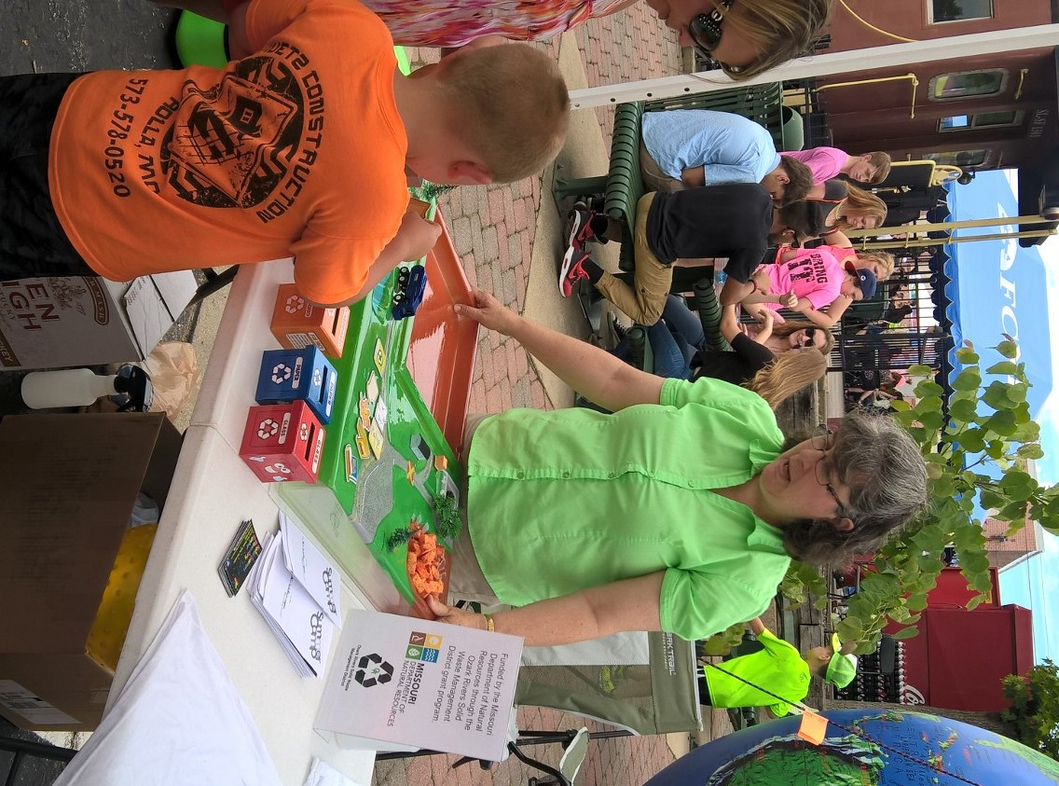
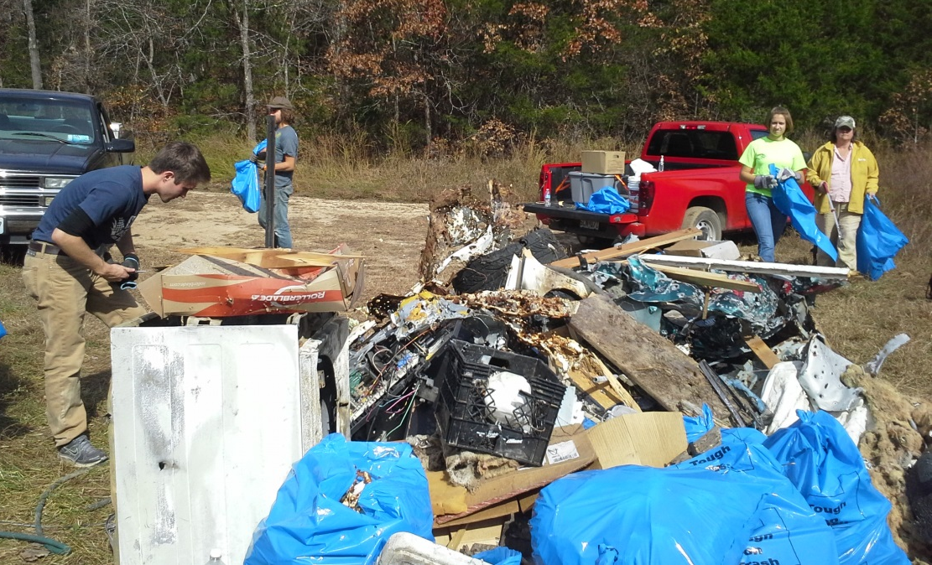
Raising Awareness
Notes:
From supporting youth activities related to solid waste to presenting landfill education at community events to organizing volunteer participation to keep our region trash free, Ozark Rivers provides assistance to the residents, schools, businesses, cities and counties. Earth Day, food composting education, etc.

Slide 21
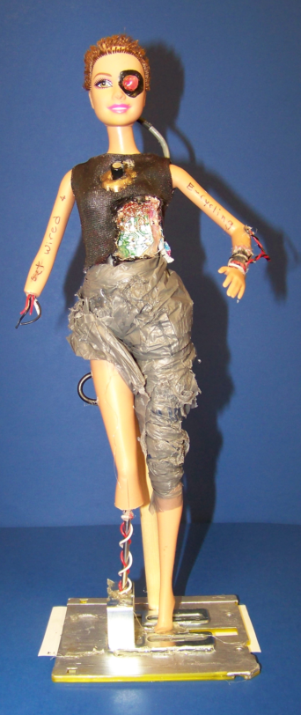
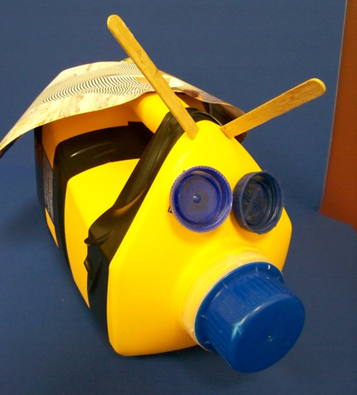
Earth Day 2016 Get Wired for E-Cycling!
Trash Art, Poster, & Graphic Art & contests for youth K-College.
Displays at Missouri S&T Earth Day and Arts Rolla
Promoted Community Electronics Collections
Notes:
The Earth Day contest is in its 26th year and serves as a tool to connect with educators and schools to promote school-based recycling program, field trips and encourage responsible behaviors. 2017 Earth Day student mantra: Let’s imagine today’s trash totally recycled. Let’s behave in such a way that shows we care.

Slide 22
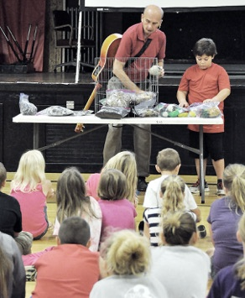
Waste Management for Schools
Food Too Good
to Waste!
Fall 2016 – 10 schools 1,829 students attended presentations
Notes:
Edutainer, Stan Slaughter has been teaching throughout the district about recycling and composting for over 15 years. Children attending his presentations learn how dirt made their lunch and this year’ they learned strategies for reducing food waste from entering landfills.

Slide 23
District Grant Projects Funded
Grant Year | Dollars Distributed
2009 | $234,334
2010 | 153,291
2011 | 238,605
2012 | 304,664
2013 | 324,583
2014 | 283,851
2015 | 325,143
2016 | 312,715
$2,177,186
funded
98 projects
in our communities
Notes:
During the last eight years, 98 projects totaling $2,177186.
Since 1996, 125 projects have been funded by a portion of landfill tipping fees collected through your solid waste management district (Region K)

Slide 24
RECENTLY COMPLETED AND ONGOING PROJECTS
Phelps County - Tough on Trash
St. James Caring Center - Recycling Program
Dixon High School - Recycle It!
Bins for Recycling - Programs in Schools
University Extension - Food Waste to Fertilizer
Environmental Education for Schools – District Wide
Enhancements Inc. - Drop-off Recycling Program
Illegal Dump Clean Up - District Wide
Household Hazardous Waste Collections -District Wide
Special Collections (Tire, Electronics, Appliances) - District Wide

Slide 25
RECENTLY COMPLETED AND ONGOING PROJECTS - continued
Waynesville R-IV School District – Recycling Program
City of Salem – Recycling Program
Maries County – Roadside Collection and Recycling
Wallace Companies’ – Business Recycling Initiative
Phelps County – Courthouse Recycling
Intergovernmental Educational Recycling Program for the Cities of St. Robert and Waynesville
Kaleidoscope Discovery Center – Recycling Education
City of St. James – Recycling Program
Curators of the University of Missouri – Composting Education

Slide 26
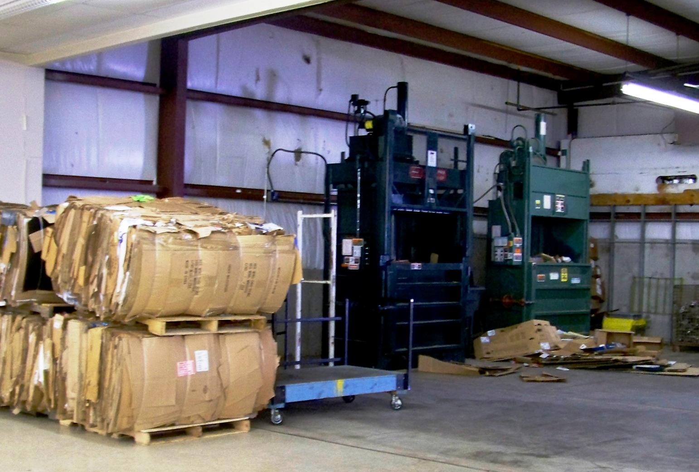
Growing Through Grants Enhancement Sheltered Workshop - Potosi
Construction of fencing, a ramp, garage door and purchase of a bailer, for a community recycling program.
Notes:
District grants have supported this sheltered workshop since 2008. The construction to update the facility in 2013 supported the creation of 5 jobs and continues the recycling of cardboard and plastics.

Slide 27
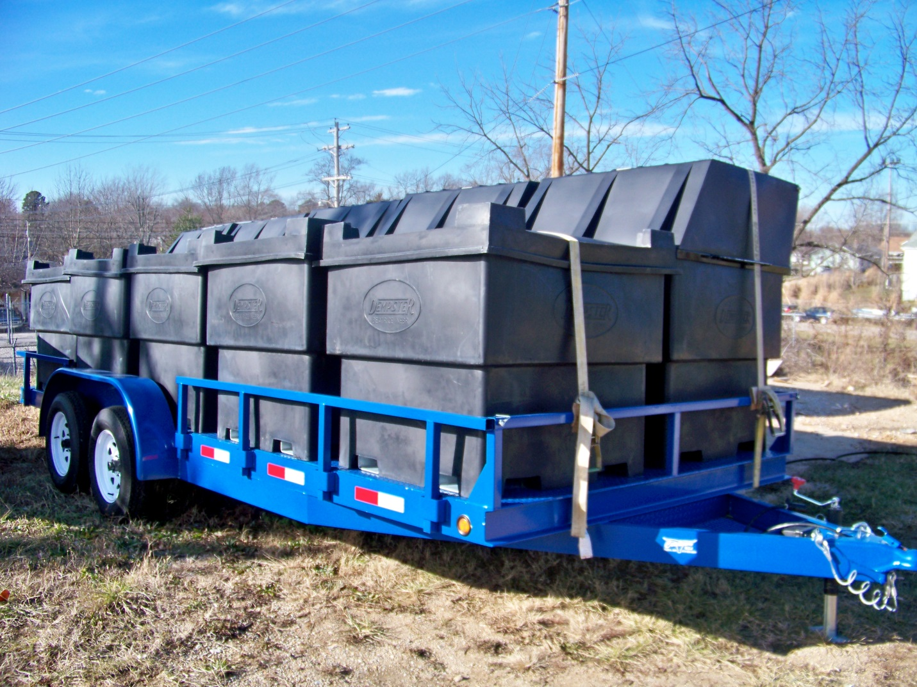
Growing Through Grants City of Salem
Purchase of a trailer and bins for a community recycling program

Slide 28
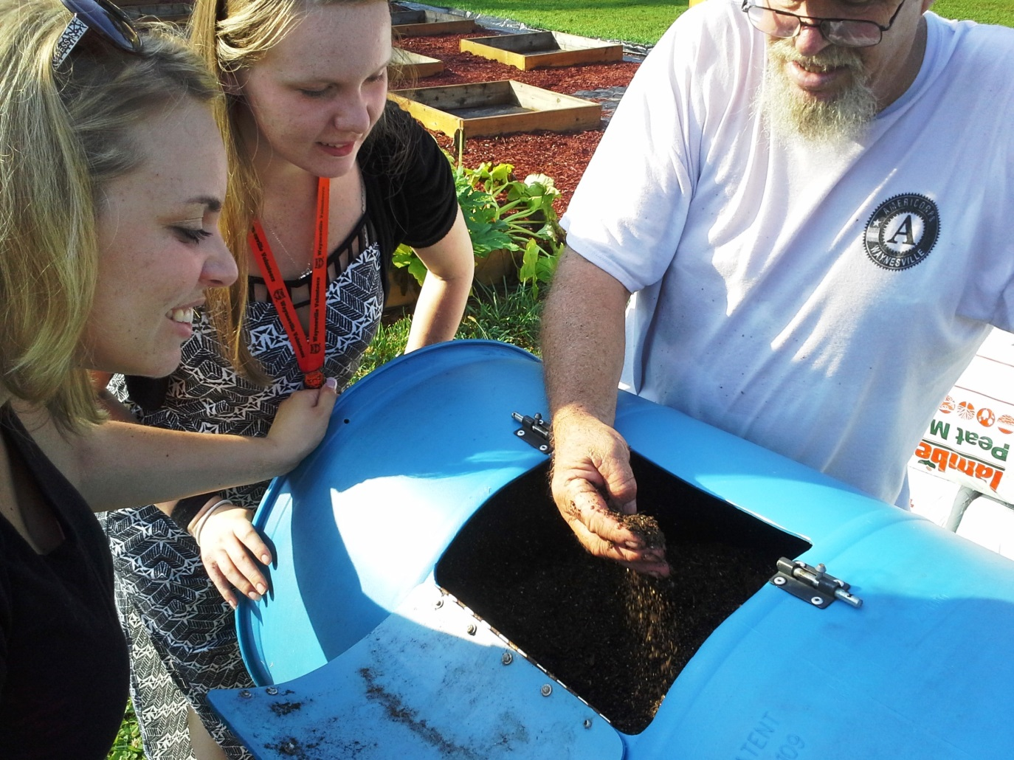
Growing Through Grants Waynesville Schools
Waynesville implemented a district wide recycling program and is now composting lunchroom food waste at the sixth grade center.

Slide 29
Dixon High School Key Club Recycling Center
Project Goal: 10 tons
Year to date as of September 30th
17.5 tons
Current: textiles, aluminum, tin, plastic, paper & cardboard
Upcoming: Increase collection of batteries and electronics
Notes:
Dixon high school Key Club continues to grow it recycling program and they are recipients of an award this evening.

Slide 30
Dixon Area Caring Center Recycling Center
Project Goal: 47.3 tons
Year to date as of September 30th
49.5 tons
Collects: textiles, aluminum, tin, plastic, paper & cardboard
Upcoming: Increase collection of batteries and electronics
Notes:
With overwhelming success, Dixon Area Caring Center provides free 24 hour recycling drop-off for the general public from both Pulaski and Maries counties. They also process unusable goods and textiles from their thrift store. The closest recycling facility is approximately 22 miles away.

Slide 31
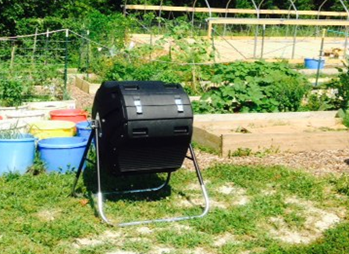
Growing Through Grants Missouri Extension Service
Richland Community Garden
Composting Demonstration
FOOD TOO GOOD TO WASTE!
Notes:
Sites for demonstration composting include: Rolla and Cuba Pathways residential living facility, Rolla Technical Institute, Rolla Middle School,
Green Forest School, Rolla Head Start, Oak Hill R-2 School, Rolla Community Garden, Richland Community Garden.

Slide 32
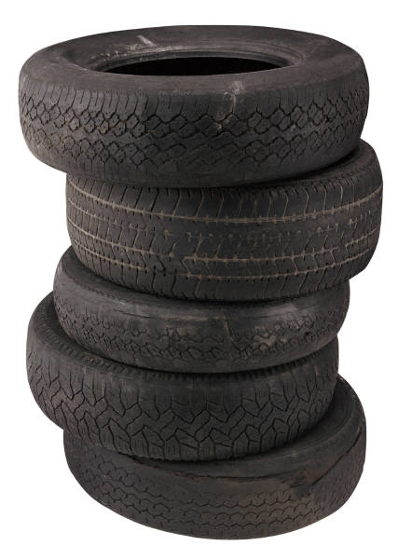
Regional Challenge: Illegally Dumped Tires
Challenge: End of MDNR’s Scrap Tire Roundup
Challenge: Financing collection of Illegally dumped tires
Develop new markets in construction applications
Road and landfill construction
Septic tank/leach fields
Alternative daily cover for landfills

Slide 33
Regional Challenge: Reduce Food Waste from Entering Landfills
Food is the single largest component of
municipal waste going to landfills!
Notes:
This fall our edutainer reached over 1,800 students across the district and raised awareness of food waste reduction as part of a national campaign through the Environmental Protections Agency.

Slide 34
Regional Challenge: Household Hazardous Waste
Paint Drop and Swap Program
Notes:
The Executive Council’s target for 2018 is increasing participation in household hazardous waste collection programs. A sub goal is having small community-based programs provide for redistribution of common products like latex paint. Please be sure to take a stack of our HHW brochures back to your office and distribute them at your meetings.
If you need additional copies, we will gladly provide them to you.

Slide 35
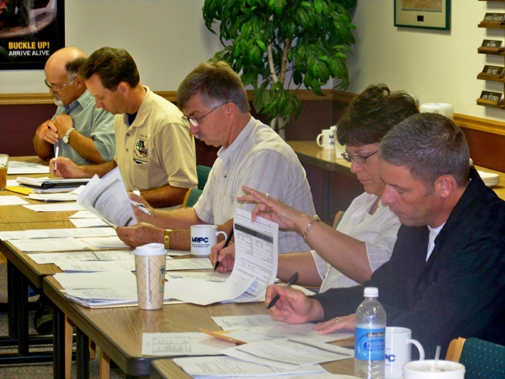
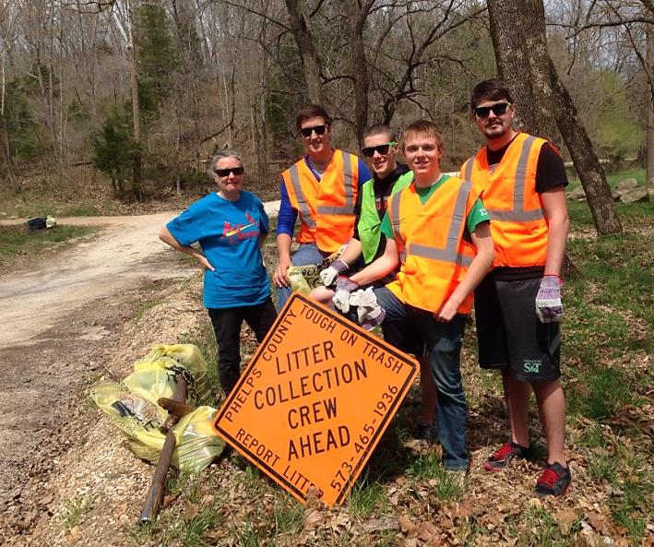
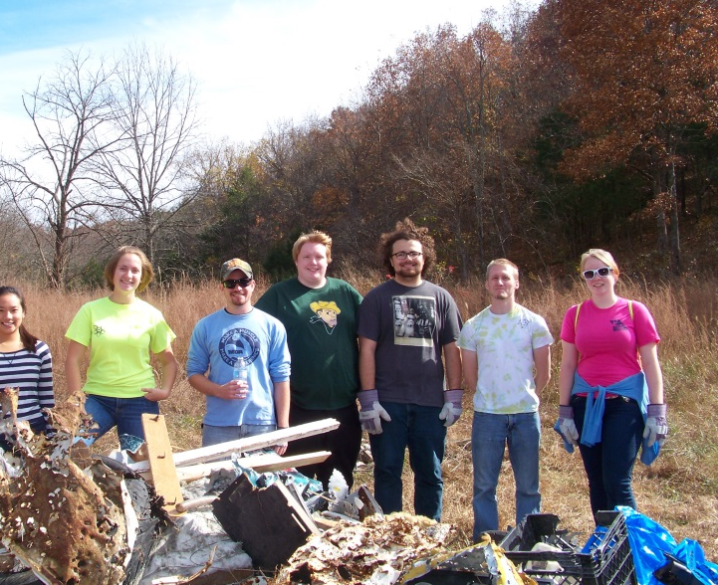
Questions or comments?
Thank you to those that have contributed their time to advance the goals of Ozark Rivers Solid Waste Management District.

Slide 37
Projects are implemented by the Meramec Regional Planning Commission with funding from the Missouri Department of Natural Resources through the Ozark Rivers Solid Waste Management District grant program.

